Slide 1

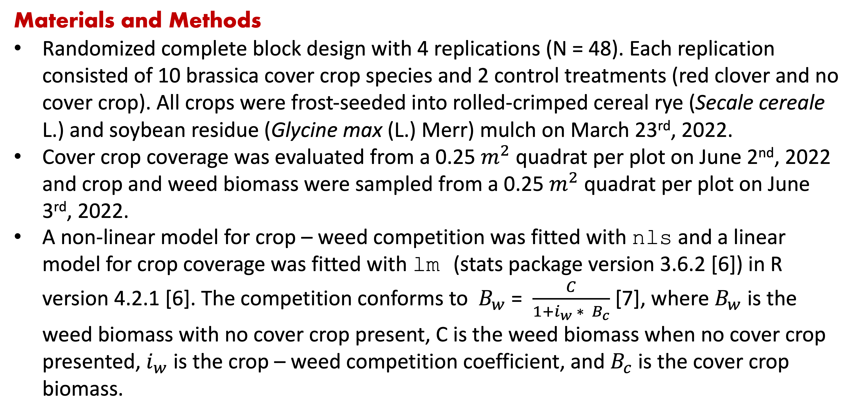
Weed suppression from frost-seeded Brassicaceae cover crops
Huong T. X. Nguyen, Olivia L. Fisher, Amy T. Fox, Kristen Loria, Kathryn F. Marini, Christopher J. Pelzer, Adam N. Sharifi, Domenic D. Varma, Sandra Wayman, Matthew R. Ryan Contact: hn337@cornell.edu
Motivation
Cover crops can suppress weeds through a variety of mechanisms, including competition for resources. Most research on cover crops has focused on grass and legume species that are seeded in the fall.
Red clover (Trifolium pratense L.) is a winter-hardy cover crop that provides multiple benefits [1] and requires minimal management [2], but its weed suppression performance is inconsistent [3,4].
Brassicas are cool-season crops. Yellow mustard, spring canola, and winter rapeseed residues, when incorporated into the soil, can reduce weed seedling emergence [5]. Can brassicas provide reliable weed suppression?
Results
Cover crop significantly reduced weed biomass
(p = 0.0137). Collard provided the strongest weed suppression among all the Brassicaceae species.
Collard’s coverage was significantly higher than that of red clover.
Materials and Methods
Randomized complete block design with 4 replications (N = 48). Each replication consisted of 10 brassica cover crop species and 2 control treatments (red clover and no cover crop). All crops were frost-seeded into rolled-crimped cereal rye (Secale cereale L.) and soybean residue (Glycine max (L.) Merr) mulch on March 23rd, 2022.
Cover crop coverage was evaluated from a 0.25 $m^{2}$ quadrat per plot on June 2nd, 2022 and crop and weed biomass were sampled from a 0.25 $m^{2}$ quadrat per plot on June 3rd, 2022.
A non-linear model for crop – weed competition was fitted with nls and a linear model for crop coverage was fitted with lm (stats package version 3.6.2 [6]) in R version 4.2.1 [6]. The competition conforms to $B_{w}$ = $\frac{C}{1+i_{w} ∗ B_{c}}$ [7], where $B_{w}$ is the weed biomass with no cover crop present, C is the weed biomass when no cover crop presented, $i_{w}$ is the crop – weed competition coefficient, and $B_{c}$ is the cover crop biomass.
References
Ohno T, Doolan K, Zibilske LM, Liebman M, Gallandt ER, Berube C. Phytotoxic effects of red clover amended soils on wild mustard seedling growth. Agriculture, ecosystems & environment. 2000 Apr 1;78(2):187-92.
Duiker SW, Curran SW. Management of red clover as a cover crop. PennState Extension. 2007 Oct.
Mutch DR, Martin TE, Kosola KR. Red clover (Trifolium pratense) suppression of common ragweed (Ambrosia artemisiifolia) in winter wheat (Triticum aestivum). Weed Technology. 2003 Mar;17(1):181-5.
Bryan CJ, Sipes SD, Arduser M, Kassim L, Gibson DJ, Scott DA, Gage KL. Efficacy of cover crops for pollinator habitat provision and weed suppression. Environmental Entomology. 2021 Feb;50(1):208-21.
Haramoto ER, Gallandt ER. Brassica cover cropping for weed management: A review. Renewable agriculture and food systems. 2004 Dec;19(4):187-98.
R Core Team (2022). R: A language and environment for statistical computing. R Foundation for Statistical Computing, Vienna, Austria. URL: https://www.R-project.org/.
Spitters CJ. An alternative approach to the analysis of mixed cropping experiments. 1. Estimation of competition effects. Netherlands Journal of Agricultural Science. 1983 Feb 1;31(1):1-1
Conclusion
Given the cover crop’s low biomass and coverage, frost seeding may not be an appropriate seeding method when soil is covered with soybean residue and mulch from cereal rye.
Acknowledgements
Keith Berns, Green Cover Seed, Bladen, Nebraska, USA, supplied the seeds.
This work was funded by USDA NIFA Organic Agriculture Research and Extension Initiative and New York State Department of Agriculture and Markets.

